Slide 1
Fitness
Women
Presented by: Eduardo López Lozano
Last Update: September 23rd, 2023

Slide 2
Table of Contents
Fitness Women
Purpose Statement
Data
Conclusions
Appendix

Slide 3
About what is it?

Slide 4
Objective
Identify the trends in the use of smart devices and apply that in the product for woman of Bellabeat

Slide 5
What is there into data?

Slide 6
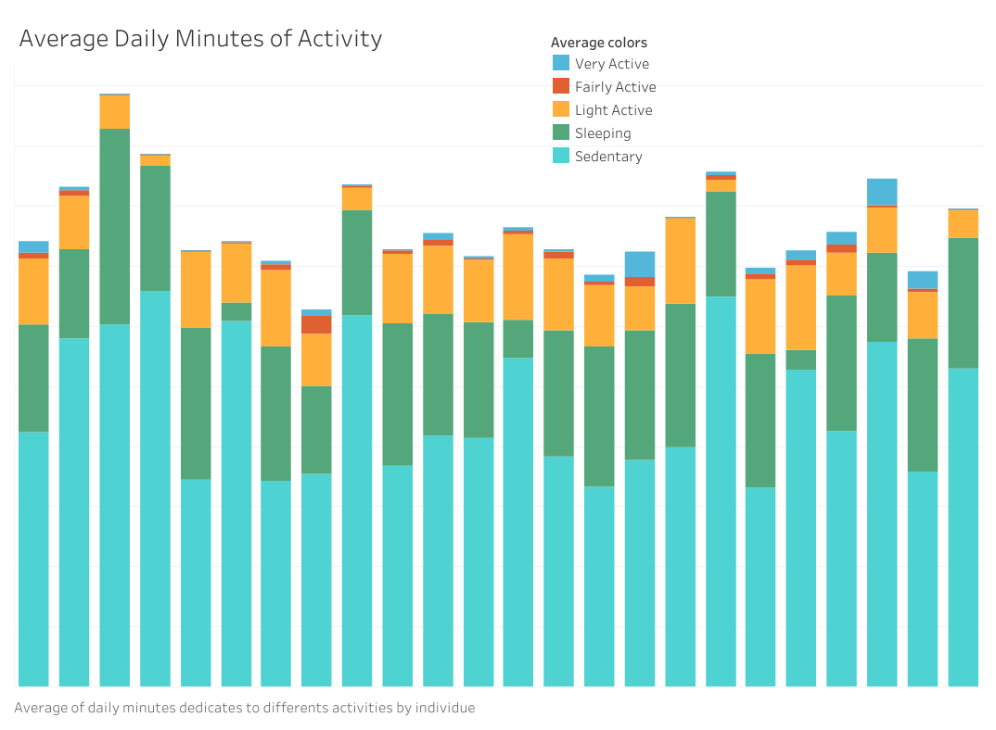
Daily Activities
Volunteers
Sedentary and sleeping activities take more minutes for volunteers in average
The volunteers prefer to do light activity

Slide 7
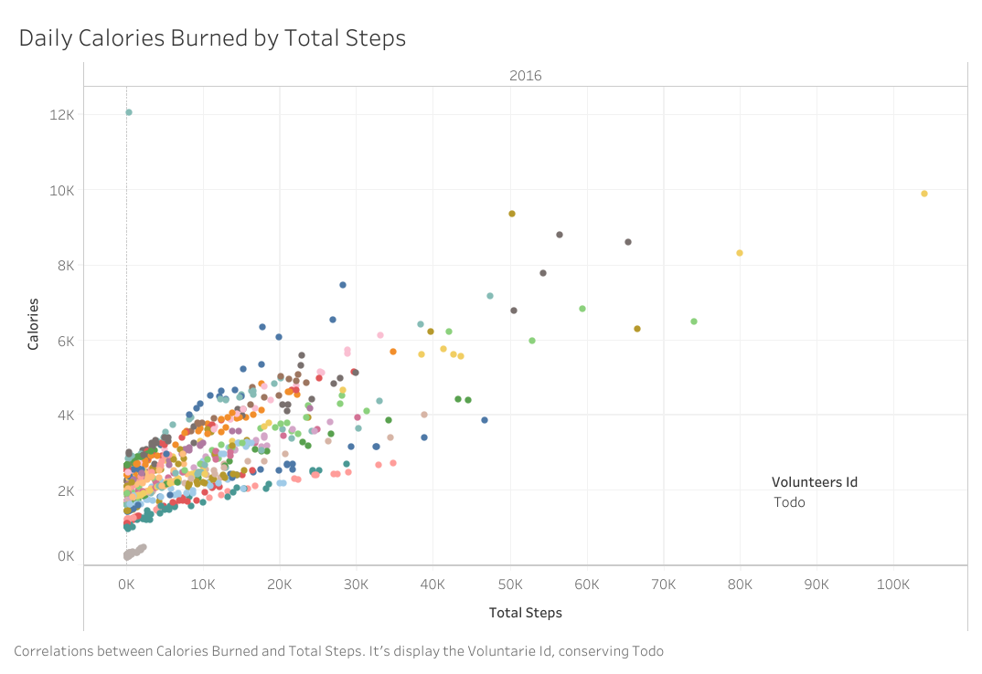
Calories and Steps
Correlations between steps and calories
More calories
Steps before 20 k, concordance with light activity
More steps

Slide 8
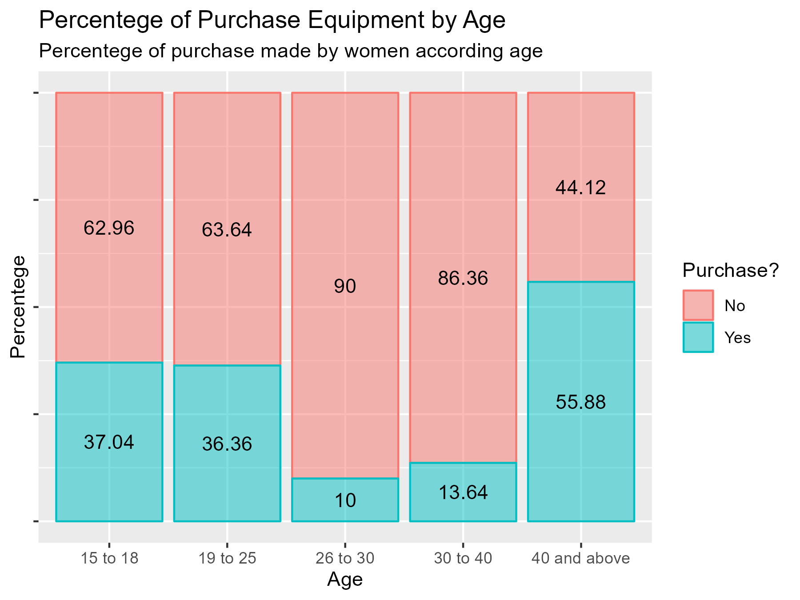
Age of women
Women above 40 years is the main group in purchase equipment
Sample of 258 women

Slide 9
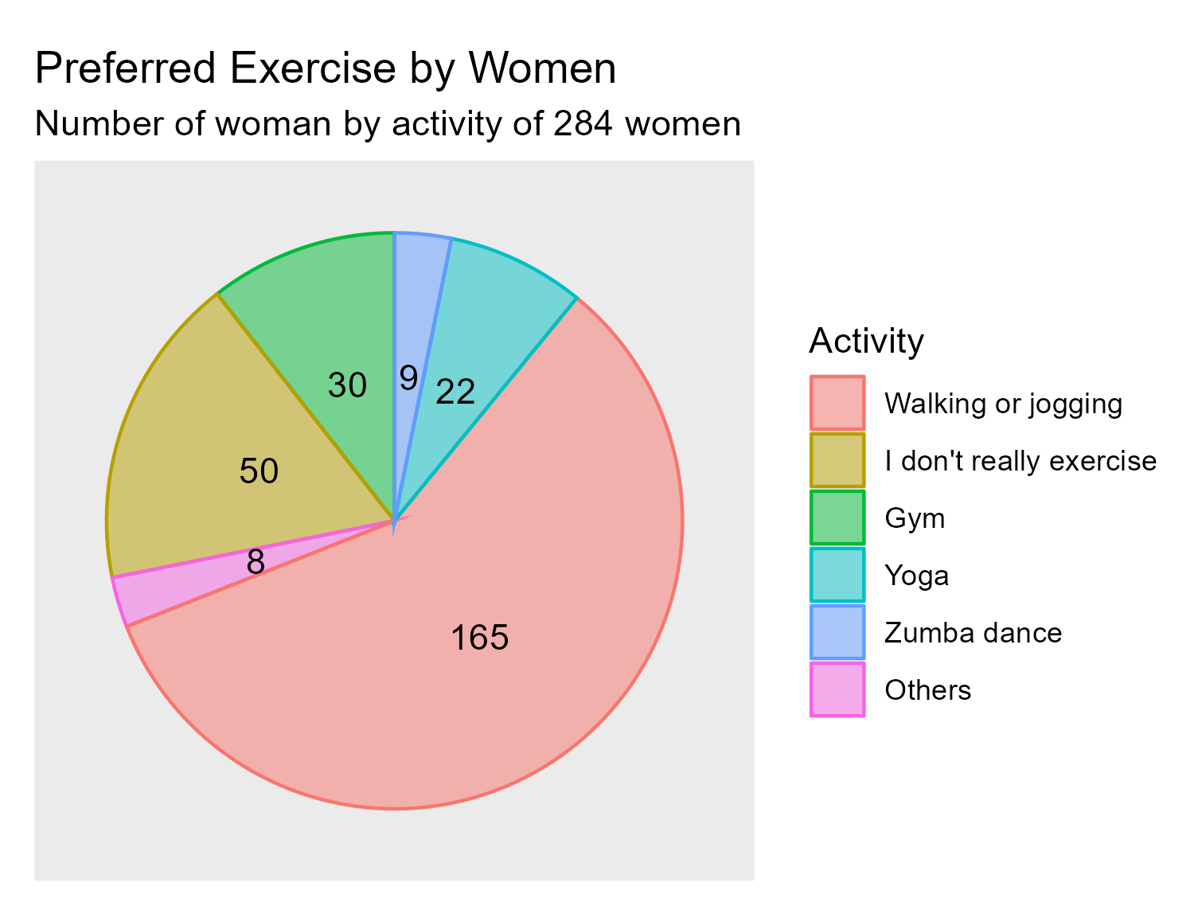
Exercise
Walking is the exercise preferred by women in all the range of age

Slide 10
Conclusions

Slide 11
Conclusions
1
Focusing the efforts on a marketing campaign for women of 40 years or above
2
Develop a product focusing on walking or jogging for that audience
3
The product shall be easy to use for that audience

Slide 12
Appendix

Slide 13
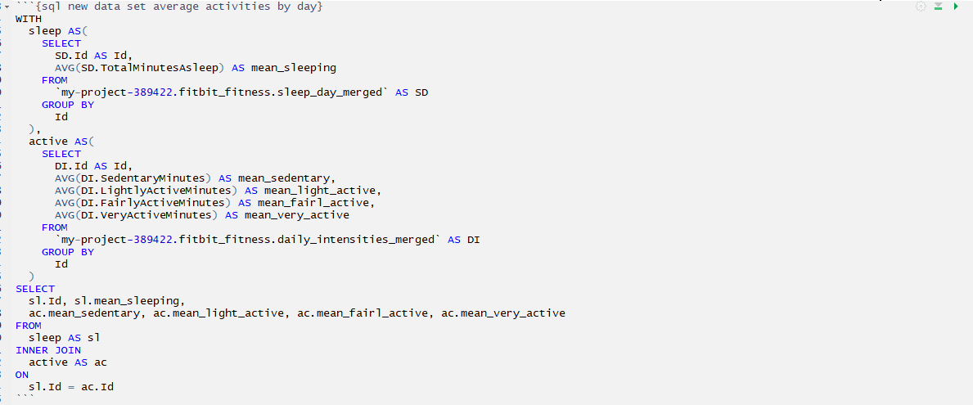
Query SQL - New frame average activities by day

Slide 14
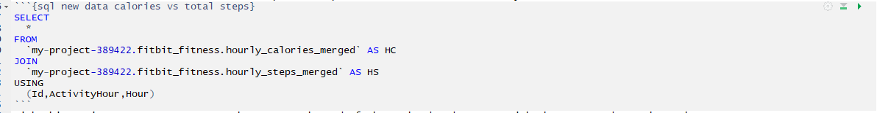
Query SQL - New frame calories vs steps

Slide 15
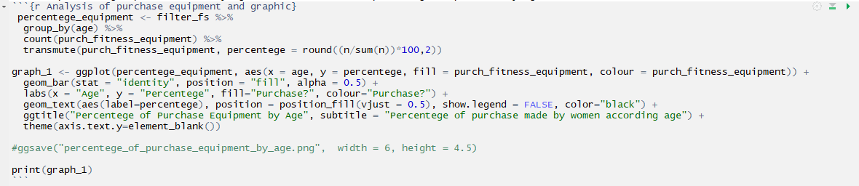
R script - filtering frame by percentage purchase and graphic

Slide 16
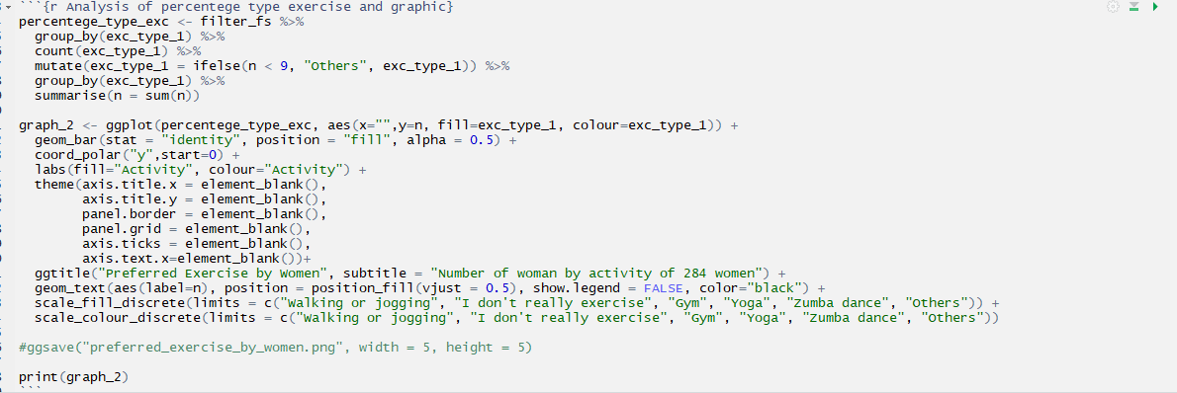
R script - filtering frame by prefer exercise and graphic

